Slide 1
412 Week 2 Progress
by: Yousef Alkhelaifi, Calvin Xaybanha, Yikun Wang, Yudi Bao, Brandon Garcia

Slide 2
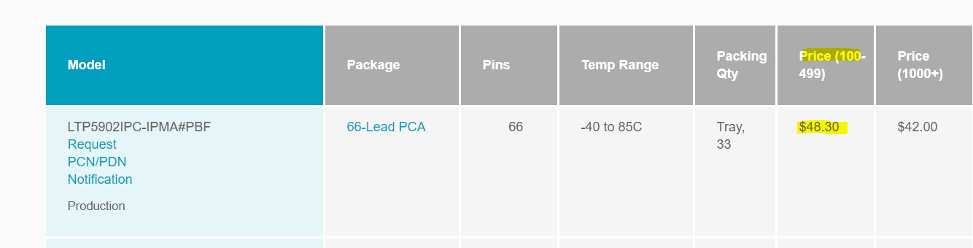
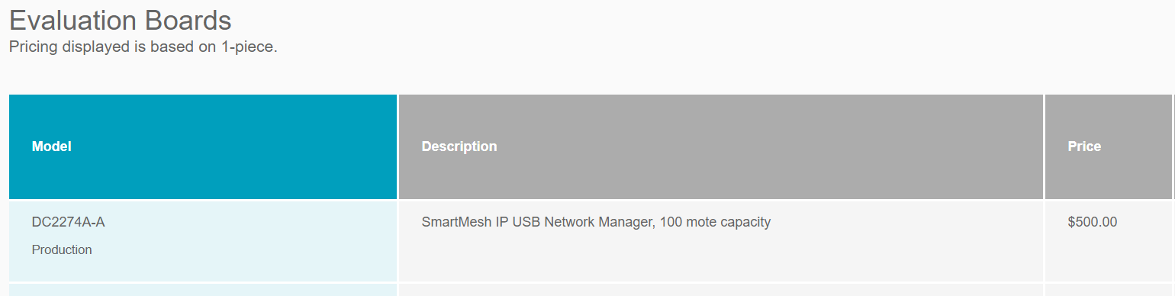
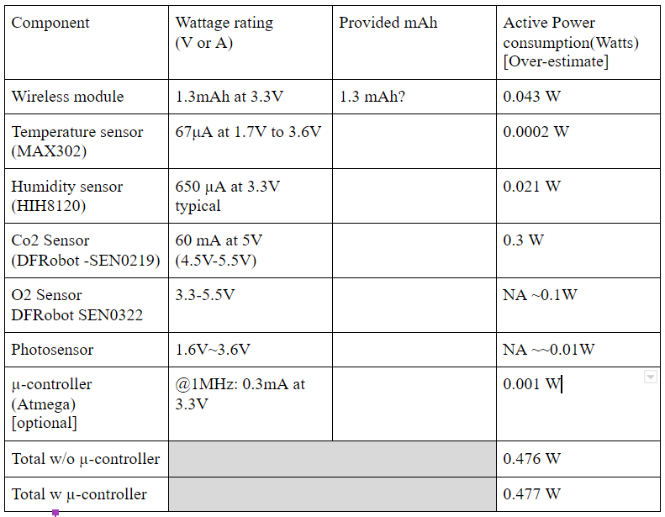
Yousef Al-khelaifi
Completed:
Research smartmesh IP capabilities and packages
Compile component research to roughly estimate power consumption (watts)
Plan out first prototype
Assign subgroups to handle different parts of the first prototype
Completed L1 diagram and added tasks to gantt chart
In-progress:
Research Ip mesh system master mode and learn how to program for it in preparation for getting the mote and manager modules
Find out how to calculate mAh per hour for more accurate battery life estimation

Slide 3
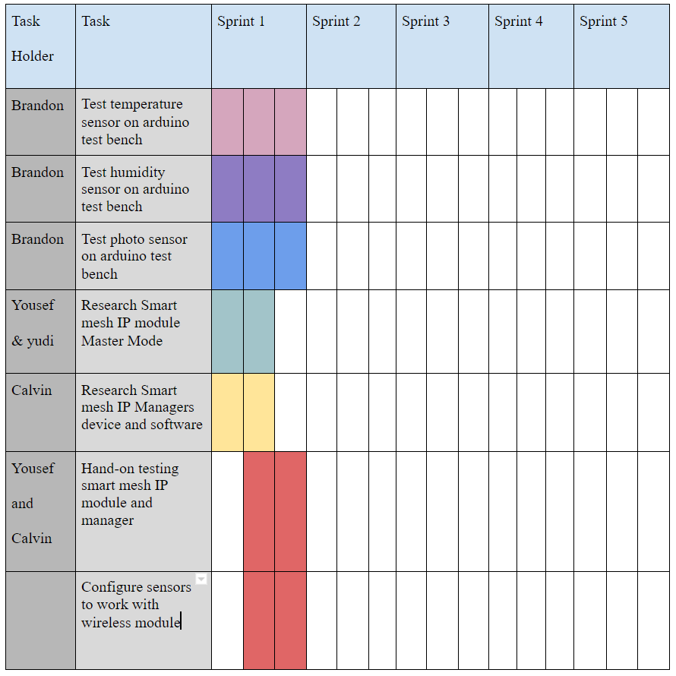
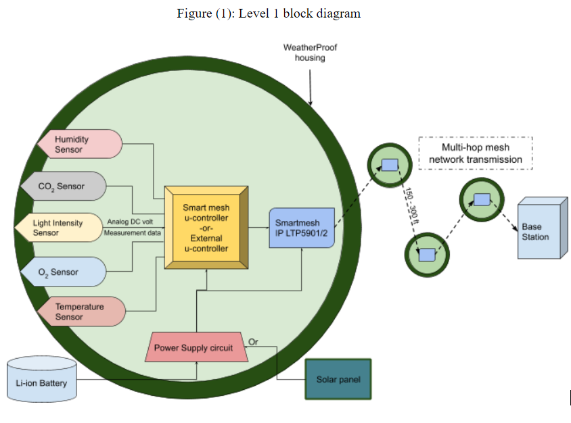

Slide 4
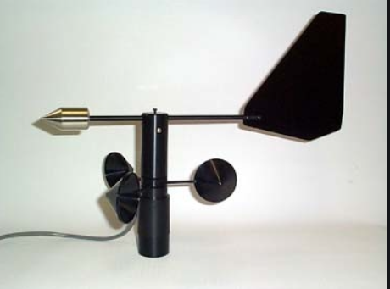
Brandon Garcia
Completed
Research on CO2, O2.
Decided on part numbers for the above sensors
In progress
Wind Speed Sensor very large?
Vibration Sensor research

Slide 5
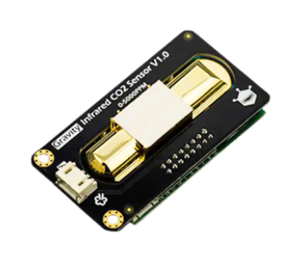
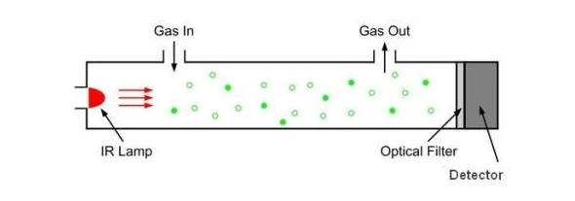
CO2 Sensor Info:
Measured in PPM(Parts Per Million)
Indoor and outdoor air has between 400 ppm and 2,000 ppm CO2 by volume
NDIR(nondispersive infrared) most common way of measuring co2 levels
Part: DFRobot SEN0219
Measures up to 5k ppm
Highly Accurate: +- 50ppm
Requires 5V
Price: $58.00

Slide 6
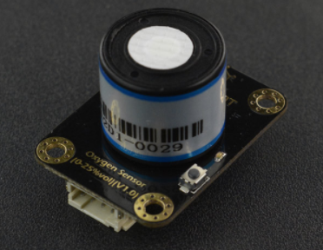
O2 Sensor Info:
Measures the ambient O2 concentration .
Range of measurement is 0- 100% Vol O2 concentration in the air.
Average ambient O2 concentration is 20.95% Vol O2.
Part: DFRobot SEN0322
Measures up to 25% Vol of O2
Stability: <2%
Operating Voltage: 3.3-5.5V
Price: $53.90

Slide 7
Yikun Wang
Completed
Research on IC Temp sensor, Light sensor
Decided the using sensors
In progress
Research on Wind speed and direction sensor

Slide 8
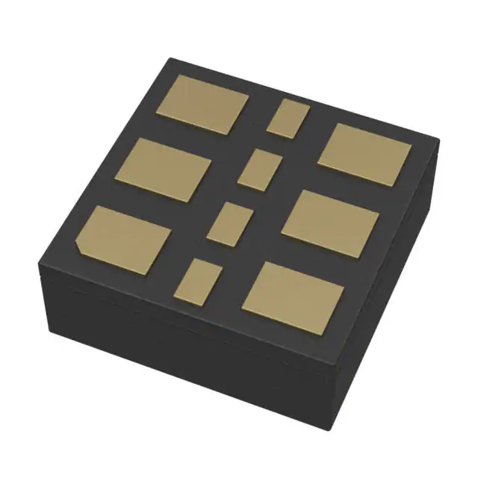
IC Temp Sensor
Small, Low thermal mass and a fast response time
Narrow temperature range: -55 to 150°C Max
MAX30208CLB+/Maxim Integrated:
IC Temperature Sensor
High Accuracy and Precision:
±0.1°C Accuracy from +30°C to +50°C
±0.15°C Accuracy from +0°C to +70°C
Operation voltage: 1.7V-3.6V
Prices: 2.77$

Slide 9
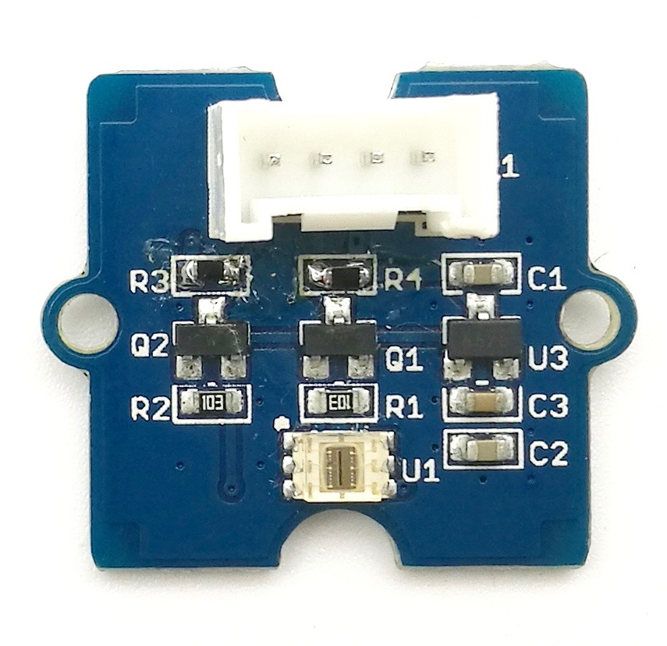
Light Sensor
A light sensor is connected to a sprinkler system, detecting levels of sunlight
The light sensor can be connected to the light system.When light sensors detect a change in light, they adjust the lighting system to the best light that the crop needs
Grove - Digital Light Sensor:
IC Light Sensor
Wide dynamic range: 0.1 - 40,000 LUX
Wide operating temperature range: -40°C to 85°C
Operation voltage: 3.3V-5V
Prices: 9.88$

Slide 10
Yudi Bao
Completed
finish the photo sensor part of PDS
Research Smartmesh IP and Mote module working principle a
Research Smartmesh IP advantage compared with arduino
In progress
Research about which concrete product we need use
Research about how to use Emanager to collect data better

Slide 11
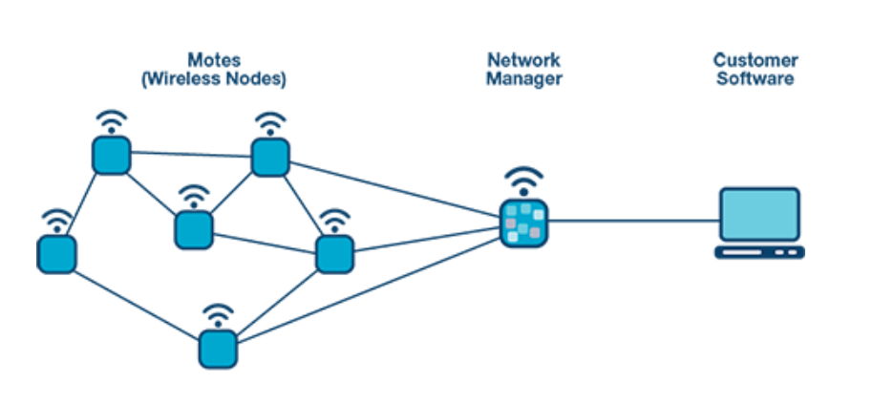
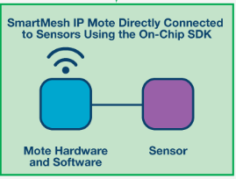
SmartMesh IP Working principle
The system is mainly composed of sensors, nodes(motes),network managers and customer software. First a variety of data is collected through sensors and then received by SmartMesh IP Motes. These Motes which carry different sensors can connect with each others because of network manager. Network Manager provides a shared wireless network for all motes. It also connects to the user's computer to use the customer software(Emanager) which can collect, relay, and monitor data. By the way this data interaction is mutual.Sensors can send data to customer Software.
The same software can also control sensors for specific collection

Slide 12
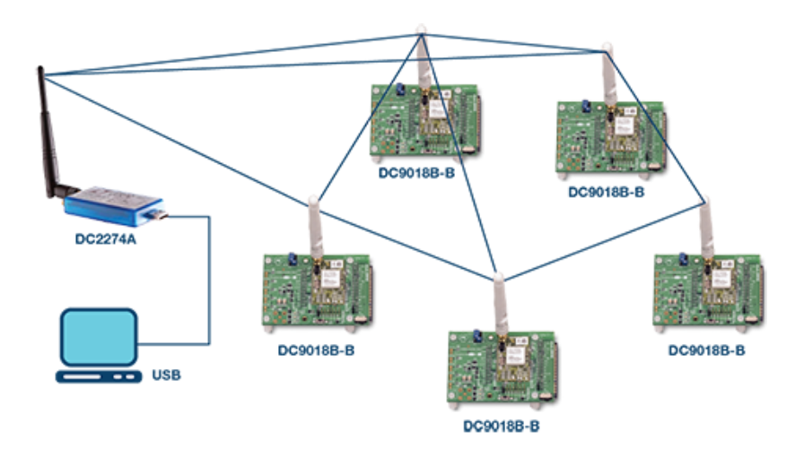
Smartmesh IP’s advantage
----Why we must use it
Low power consumption(the most important factor)
A professional online data center which can collect, relay, monitor great capacity of data
Extremely short reaction speed and rapid system feedback
small size of the system hardware
Over the air programing capabilities (mastemode)

Slide 13
Calvin Xaybanha
Completed
Research SmartMesh IP Manager Software (Serial Termination Program e.g. Tera Term)
CLI used for development/interactive troubleshooting communication to Manager
API used for host program to Manager
Research on sensors (temperature/humidity, CO₂)
Recommended sensors:
Temperature: MAX30208CLB+
Humidity: HIH8120-021-001
CO₂: SGP30
In progress
Research usability of a GUI for an end-user
Research SmartMesh module integration with Network Manager

